Slide 1
EmotionGIF 2020
GloVe+LSTM
TEAM
Delta
Pre-Processing
Emojis
Word Cloud of each Categories
Word Embedding
Model
incomplete data
0856733 Hank Huang
0856109 Warren Fang
0856065 Sz Yu Chen

Slide 2
EmotionGIF 2020
GloVe+LSTM
OUTLINE
Pre-Processing
Emojis
Word Cloud of each Categories
Word Embedding
Model
incomplete data
0856733 Hank Huang
0856109 Warren Fang
0856065 Sz Yu Chen
TEAM
Delta

Slide 3
Emojis
Pre-Processing
We’re Team Delta! We love NLP sooooo much ❤😂 #NLPTHEBEST
TEAM
Delta
Step 1. Lower case
we’re team delta! we love nlp sooooo much ❤😂 #nlpthebest

Slide 4
Emojis
Pre-Processing
We’re Team Delta! We love NLP sooooo much ❤😂 #NLPTHEBEST
Step 1. Lower case
we’re team delta! we love nlp sooooo much ❤😂 #nlpthebest
TEAM
Delta
Step 2. Stemming
Step 3. Tokenize
[“we”, ”are”, “team”, “delta”, “!”, “we”, “love”, “nlp”, “so”,
“much”, “❤”, “😂”, “#nlpthebest”]
Stop words, e.g. : I’ve → I have
Weird words, e.g.: yeeeessss → yes
Use TweetTokenizer
we are team delta! we love nlp so much ❤😂 #nlpthebest

Slide 5
Emojis
Pre-Processing
We’re Team Delta! We love NLP sooooo much ❤😂 #NLPTHEBEST
Step 1. Lower case
we’re team delta! we love nlp sooooo much ❤😂 #nlpthebest
Step 2. Stemming
Stop words, e.g. : I’ve → I have
Weird words, e.g.: yeeeessss → yes
we are team delta! we love nlp so much ❤😂 #nlpthebest
TEAM
Delta
Step 3. Tokenize
[“we”, ”are”, “team”, “delta”, “!”, “we”, “love”, “nlp”, “so”,
“much”, “❤”, “😂”, “#nlpthebest”]
Step 4. Cleaning
Use TweetTokenizer
Remove:
Punctuations
Numbers
#hashtag
@tag
URL

Slide 6
Emojis
Pre-Processing
We’re Team Delta! We love NLP sooooo much ❤😂 #NLPTHEBEST
Step 1. Lower case
Step 2. Stemming
Stop words, e.g. : I’ve → I have
Weird words, e.g.: yeeeessss → yes
we are team delta! we love nlp so much ❤😂 #nlpthebest
Step 3. Tokenize
Use TweetTokenizer
[“we”, ”are”, “team”, “delta”, “!”, “we”, “love”, “nlp”, “so”,
“much”, “❤”, “😂”, “#nlpthebest”]
TEAM
Delta
Step 4. Cleaning
Remove:
Punctuations
Numbers
#hashtag
@tag
URL

Slide 7



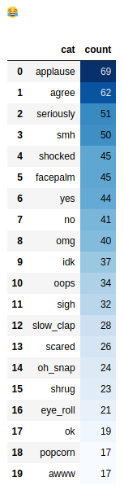

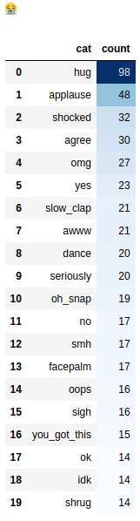

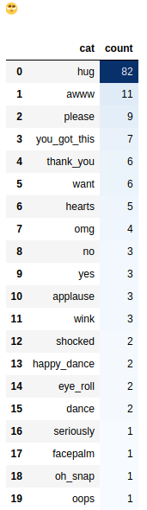
Remain for main text:
Emojis
Pre-Processing
We’re Team Delta! We love NLP sooooo much ❤😂 #NLPTHEBEST
Step 1. Lower case
Step 2. Stemming
Stop words, e.g. : I’ve → I have
Weird words, e.g.: yeeeessss → yes
Step 3. Tokenize
Use TweetTokenizer
Step 4. Cleaning
[“we”, ”are”, “team”, “delta”, “!”, “we”, “love”, “nlp”, “so”,
“much”, “❤”, “😂”, “#nlpthebest”]
Remove:
Punctuations
Numbers
#hashtag
@tag
URL
TEAM
Delta
Remain for reply:

Slide 8

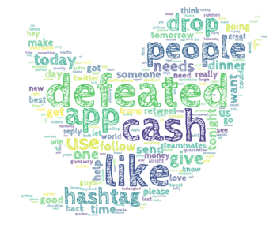

Pre-Processing
Word Cloud of each Categories
Emojis
Some emojis are important…
Remain for main text:
Remain for reply:
TEAM
Delta

Slide 9
Remain for main text:
Word Embedding
Emojis
Pre-Processing
Word Cloud of each Categories
Category “hug”:
Category “please”:
TEAM
Delta
Remain for reply:

Slide 10
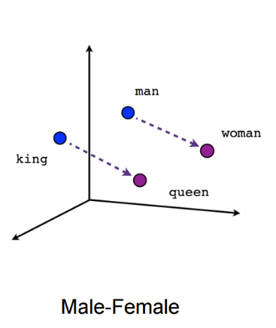
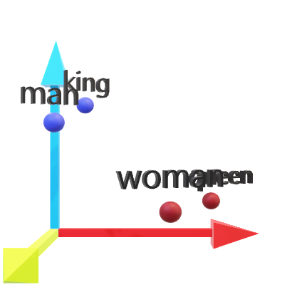
Word Cloud of each Categories
Word Embedding
“nlp” →
[-0.12459, -0.37272, -0.26352, …, 0.86152 ]
Our method to embedding words
0 1
(100d) GloVe for twitter+emoji2vec
“i”
“love”
“nlp”
[[0.25314, 0.75214, -0.48742, …, 0.42746 ],
[-0.49779, 0.25438, 0.53452, …, -0.32544 ],
[-0.12459, -0.37272, -0.26352, …, 0.86152 ],…]
0 2
Embedding matrix
0 3
Padding
[“i“, “love”, “nlp”] →[0,0,0,0,…,0,1,2,3]
TEAM
Delta

Slide 11
Model
Word Embedding
0 1
(100d) GloVe for twitter+emoji2vec
“nlp” →
[-0.12459, -0.37272, -0.26352, …, 0.86152 ]
0 2
Embedding matrix
“i”
“love”
“nlp”
[[0.25314, 0.75214, -0.48742, …, 0.42746 ],
[-0.49779, 0.25438, 0.53452, …, -0.32544 ],
[-0.12459, -0.37272, -0.26352, …, 0.86152 ],…]
0 3
Padding
[“i“, “love”, “nlp”] →[0,0,0,0,…,0,1,2,3]
TEAM
Delta

Slide 12
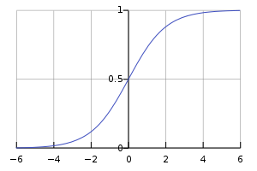
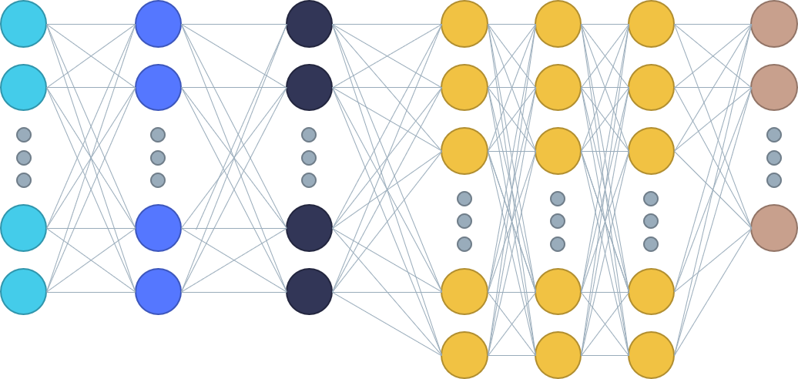
Word Embedding
Model
Long short-term memory (LSTM)
0 1
Possibility of each category
[0.25314, 0.75214, 0.98742, …, 0.42746 ]
0 2
Choose Top 6
[0, 1, 1, …, 0]
Dense
Sigmoid
Output: (x,43)
Decode
Input
layer
Embedding
Dropout
0 3
[“hug”, “applause”,…]
Output: (x,y,100)
Output: (x,y,100)
LSTM
Output: (x,y)
Output: (x,y,128)
Output: (x,y,256)
Output: (x,128)
TEAM
Delta

Slide 13
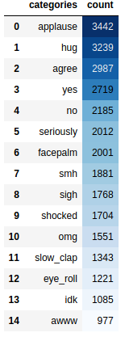
incomplete data
Model
Long short-term memory (LSTM)
One model for text
0 1
Possibility of each category
[0.25314, 0.75214, 0.98742, …, 0.42746 ]
0 2
Choose Top 6
[0, 1, 1, …, 0]
One model for reply
Decode
0 3
[“hug”, “applause”,…]
TEAM
Delta
After our preprocessing, some text will become empty.
Guess the 6 most common categories

Slide 14
Model
incomplete data
After our preprocessing, some text will become empty.
Guess the 6 most common categories
TEAM
Delta

Slide 15
Thanks
For your Listening
incomplete data
GitHub: https://github.com/hannnnk1231/EmotionGIF-2020
After our preprocessing, some text will become empty.
Guess the 6 most common categories

Slide 16
Note:
本页为主题使用说明页，使用时请删除本页内容。
This is a instru ction for theme, please delete this slide before presentaion.
主题模板的标准 How to use this template
主题色彩 THE ME COLORS
预设参考线 （2013版本及以上） GUIDES
文字/背景 Text /Background
填充色 Acce nts
*可以通过 iSlide 【色彩库】功能，快速应用更多色彩
Use Color Library to apply theme colors.
主题字体 THEME FO NTS
中文字体：微软雅黑 Asian Font: Microsoft Yahei
英文字体：Arial Lation F ont: Arial
ALT+F 9 开启和查看本主题预设的参考线
Use Alt + F9 to display/hidden guides.
*可以在【设计】菜单【字体】中改变，或应用iSlide【统一字体】功能改变设置。
Use Design, V ariants, Fonts to change theme fonts, or just use Uniform Fonts in iSlide.
*可以通过iSlide 【一键优化】（智能参考线）功 能，应用更多预设参考线。
Use Uniform Guides in iSlide to apply guides with presets.
Notes:
iSlide，让PPT设计简单起来！
iSlide, Make PowerPoint Design Simple!

Slide 17
快速设计页面 Quick de sign slides
Note:
本页为主题使用说明页，使用时请删除本页内容。
This is a instruction for t heme, please delete this slide before presentaion.
1
使用【图示库】筛选图示
Use Diagram Li brary to search diagram
2
选择图示插入当前PPT主题，编辑修改文字，替换图标或填充图片
Click to insert diagram into curre nt presentation, edit text, replace icon or fill pictures.
图示库/Diagram Libra ry
?
获取更多帮助
Get more help
Notes:
iSlide，让PPT设计简单起来！
iSlide, Make PowerPoint Design Simple!

Slide 18

PPT“一键”美化神器
180K+专业PPT素材资源下载
让PPT设计简单起来！
All-In-One PowerPoint Design Add-in
180K+ P rofessional PowerPoint Resources
www.islid e.cc
关注官方微信公众号
Follow us on WeChat
iSlide 版权声 明 COPYRIGHT NOTICE
本素材由iSlide 提供
iSlide 尊重知识产权并注重保护用户享有的各项权利。郑重提醒您：
iSlide 插件中提供的任何信息内容的所有权、知识产权归其原始权利人或权利受让人所有，您免费/购买获得的是信息内容的使用权，并受下述条款的约束；
1. 您仅可以个人非商业用途使用该等信息内容，不可将信息内容的全部或部分用于出售，或以出租、出借、转让、分销、发布等其他任何方式供他人使用；
2. 禁止在接入互联网或移动互联网的任何网站、平台、应用或程序上以任何方式为他人提供iSlide 插件资源内容的下载。
The resource is supplied by iSlide.
iSlide respects all intellectual property rights and protects all the rights its users acquir ed. Solemnly remind you:
The ownership and intellectual property of the resources supplied in iSlide Add-in belongs to its owner or the assignee of this ownership. you only acquired the usage of the resources supplied in iSlide Add-in, as well as respected the following restrain terms:
1.You are only allowed to use such resource for personal and non-commercial aim, not allowed to use such resource or part of it for the sale; or rent, lend, transfer to others; or distribution or release it in any way.
2.You are not permitted to provide the resource of iSlide Add-in in any website, platform, application access to the Internet or mobile Internet.
Notes:
本素材由iSlide 提供
iSlide 尊重知识产权并注重保护用户享有的各项权利。郑重提醒您：
iSlide 插件中提供的任何信息内容的所有权、知识产权归其原始权利人或权利受让人所有，您免费/购买获得的是信息内容的使用权，并受下述条款的约束；
1. 您仅可以个人非商业用途使用该等信息内容，不可将信息内容的全部或部分用于出售，或以出租、出借、转让、分销、发布等其他任何方式供他人使用；
2. 禁止在接入互联网或移动互联网的任何网站、平台、应用或程序上以任何方式为他人提供iSlide 插件资源内容的下载。
The resource is supplied by iSlide .
iSlide respects all intellectual property rights and protects all the rights its users acquired. Solemnly remind you:
The ownership and intellectual property of the resources supplied in iSlide Add-in belongs to its owner or the assignee of this ownership. you only acquired the usage of the resources supplied in iSlide Add-in, as well as respected the following restrain terms:
1.You are only allowed to use such resource for personal and non-commercial aim, not allowed to use such resource or part of it for the sale; or rent, lend, transfer to others; or distribution or release it in any way.
2.You are not permitted to provide the resource of iSlide Add-in in any website, platform, application access to the Internet or mobile Internet.

